Slide 1
People's Community Clinic
Financial Overview
Student’s Name
Institution
Date

Slide 2
Summary
The People’s Community Clinic is a project aimed at improving the health of the medically uninsured and underserved population from Central Texas.
The results obtained include affordability of health care treatment, high quality, dignity, and respect.
The program has sections for patients where the information contained in the database can be used to offer treatment without undergoing the consultation process.
Patient history is made readily available. Some of the PCC statistics are as shown in the diagram below.

Slide 3
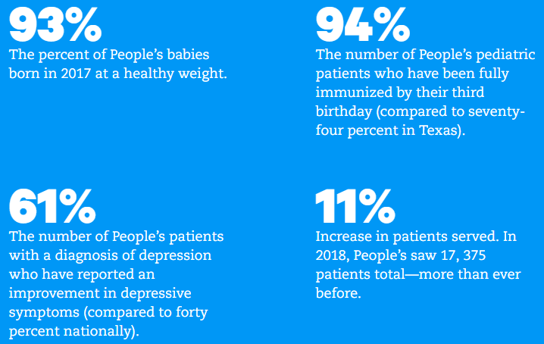
Summary Statistics

Slide 4
Financial Position
PCC indicates a strong and healthy financial position where the available cash and cash equivalents can be used to finance falling obligations due.
Due to the dependency on donors and sponsors, the organization operates at a ow long-term debt that can be settled ant time upon falling due (Easton & Sommers, 2018).
For example, the statement of financial position indicates a cash and cash equivalent available of $9 million while the reported long-term debt is $108,333.

Slide 5
Operations
Despite PCC being a society sponsored organization in improving the health facilities and treatment for the Texans, the revenue collected from offering services to patients realizes a bigger share that can sustain its operation.
However, the portion of expenses covered by salaries and wages consumed a greater part of the revenues collected (Riantani & Nurzamzam, 2015).
For example, the financial period of 2015, the collected revenues from patient services amounted to $9 million while salaries and wages paid for the same financial period amounted to $8.6 million.
Under such instances, PCC cannot realize and make progress if the revenues collected within a fiscal period are utilized within the same period.
Such conditions can only operate during a break-even point but upon a long-term exercise, failure can be inevitable.

Slide 6
Liability Risk
PCC generates more revenue from patient services and other sources.
However, the collected revenue allows the organization to introduce more services because the financial resources are available.
The reported liabilities sum $2 million while the net assets figure is $26 million. Having such a stable financial removes doubt and fear on the perpetual concept of PCC.
Nevertheless, the high amount spent on paying expenses pose a high risk of experiencing financial difficulties.

Slide 7
Cash Flows
Raising cash for PCC can never be a challenge due to the reported cash flow statement that offers an indication that the credit score of the organization is good.
The better cash flow management can be obtained from the financial excerpt of the cash flow statement for the period of 2015 & 2014 respectively.
The report indicate consistence from the previous periods because the net cash and cash equivalents for the period of 2015 and 2014 can be found to be $4.3 million and $4.8 million respectively.

Slide 8
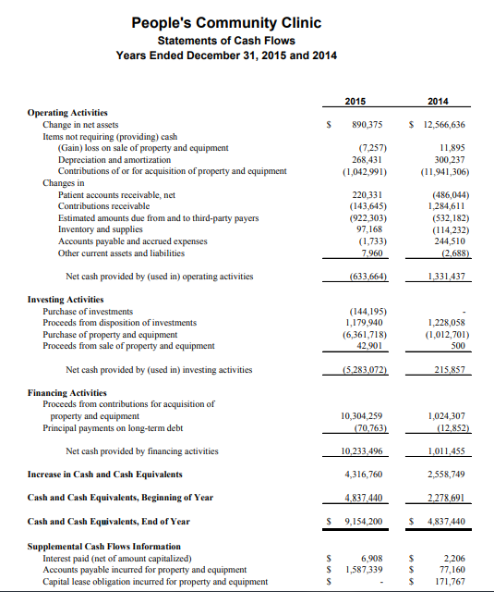
Cash Flow

Slide 9
Year-End Status Summary
According to the three major financial statements (balance sheet, statement of operations,
and cash flow statement) analyzed, the period ending 2015 can be summarized to be a better period than the previous period of 2014.
the reduction of the long-term from $168,357 to $108,333 the fiscal periods of 2014 and 2015 respectively can indicate a positive change in the reduction of debt by over $60,000.

Slide 10
Year In-Progress Assumptions
The current financial period financial position is better than the previous.
The reported cash and cash equivalent for the current period is twice the previous period’s amount.
In such a great improvements, PCC can be assumed to have a positive trend in maintaining the organization’s financial stability.

Slide 11
References
Easton, M., & Sommers, Z. (2018). Financial Statement Analysis & Valuation, 5e.
https://www.austinpcc.org/wp-content/uploads/2016/12/PCC-2015-Financial-Audit-Report.pdf
Riantani, S., & Nurzamzam, H. (2015). Analysis of Company Size, Financial Leverage, and Profitability and It’s Effect to CSR Disclosure. Jurnal Dinamika Manajemen, 6(2).

